Slide 1


Slide 2

SILLY SINGS SONGS
CHITKARA UNIVERSITY
MADE BY →
SUBMITTED TO RESPECTED :
JATIN GARG
ISHAAN SINGLA
JAY SHREE PATEL
JASSIKA POPLI
MISS. NEHA SHARMA

Slide 3
Abstract—This game purpose is to have fun , there are several Hindi songs whose lyrics are given in English and there are several English songs whose lyrics are written in hindi.so you are given 10 seconds to guess the song name , all the songs would be most popular songs ,so it would not be tough to guess.
Keywords—Introduction, music guessing games, The proposed approach, literature review, reference ,methodology , flow chart , results, conclusion.

Slide 4
Introduction
Music is the art of sound. Sound is invisible waves moving through the air around us. When something vibrates, it disturbs the air molecules around it. Music is sound that is organized by people on purpose, to dance to, to tell a story, to make other people feel a certain way, just to sound pretty or be entertaining. Music gives you wings, it relax your mind.

Slide 5
Music guessing games
Currently, the most used mobile platforms are Android and iOS. Given that the majority of games have version for both of them, and in order to facilitate the MGG analysis, we compared only iOS available games.
Response type: you would be given 30 seconds and lyrics of songs to guess the name of the song .
Clues: The volunteer would be given lyrics thirty seconds to guess.
Full song playback: no the player wouldn’t be given audio they have to just guess by lyrics
Score calculation: when ever the player guess the right the guess right answer. They would be appreciated (Hurrah!).

Slide 6
Literature Review
Reference number | Year | author | algorithm
[1] | 2018 | Bosch-Rosa, C., Meissner, T | How to guess games
[2] | 2017 | Yuliani.shree | How to develop speaking skills through guessing games
[3] | 2016 | Wright, A. T | Teaching skills to master the problem solving ability
[4] | 2022 | Jennie C. Ross | Playing games and how to score points
[5] | 2017 | Elsevier B.V. | Positive expectations feedback experiments and number guessing games
[6] | 2019 | J Econ Sci Assoc | Understanding decision processes in guessing games: a protocol analysis approach
[7] | 2017 | Marina Agranov | Naive Play and the Process of Choice in Guessing Games
[8] | 2019 | Deguang Zhu | Using Games to Improve Students' Communicative Ability
[9] | ²⁰¹⁸ | Juin kaun chong | A psychological approach to strategic thinking in games
[10] | 2019 | Agus Niarti, Ikhsanudin, Wardah | IMPROVING STUDENT’S VOCABULARY THROUGH GUESSING GAMES

Slide 7
reference
article.php (kemdikbud.go.id)
A psychological approach to strategic thinking in games – ScienceDirect
Introduction (academypublication.com)
NaivePlayAndChoiceInGuessingGames.pdf (psu.edu)
Understanding decision processes in guessing games: a protocol analysis approach | SpringerLink
Play games and score points with students - Biehle - 2018 - The Clinical Teacher - Wiley Online Library
THE EFFECT OF JEOPARDY GAME TOWARD STUDENTS’ VOCABULARY MASTERY | ELP (Journal of English Language Pedagogy) (fkipummy.ac.id)
The one player guessing game: a diagnosis on the relationship between equilibrium play, beliefs, and best responses | SpringerLink
DEVELOPING STUDENTS SPEAKING SKILL TROUGH GUESSING GAMES | Sukerni | Yavana Bhasha : Journal of English Language Education (ihdn.ac.id)
The one player guessing game: a diagnosis on the relationship between equilibrium play, beliefs, and best responses | SpringerLink

Slide 8
Methodology
Hardware Requirements:
Software Requirements:
• Laptop/ Computer
• Keyboard/ Mouse
• CPU Ryzen 3000s/ Intel core i3
• Storage – 64 GB
• RAM – 2 GB
• Printer
• Screen Resolution 1080 x 720
• Windows XP/7/8/10/11
• Mac OS
• Linux
• x32 bit processor
• Python 3 or above
• PyCharm

Slide 9
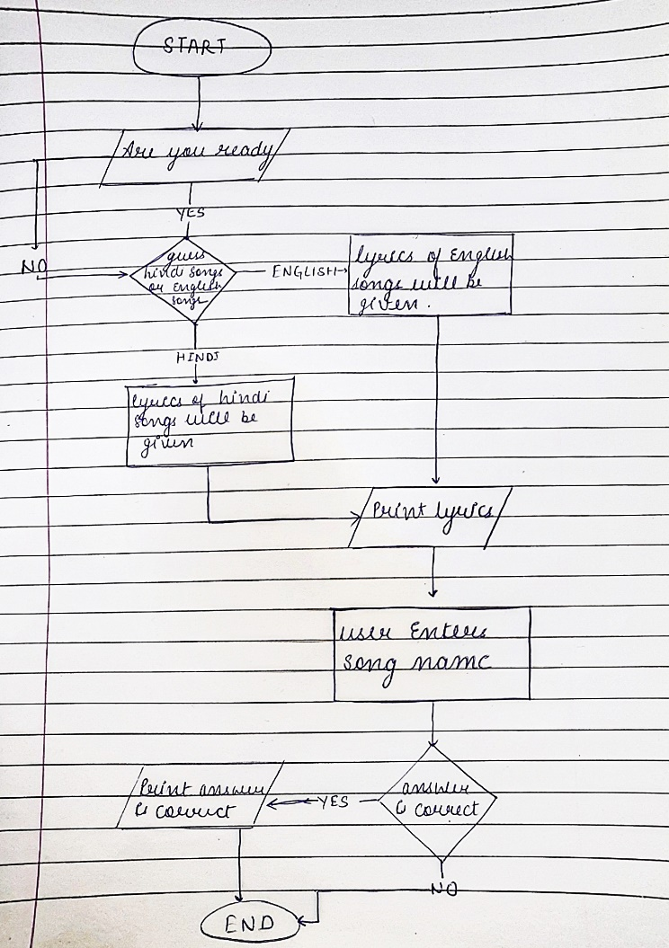
Flow chart

Slide 10
Conclusion
These games increase efficiency of our brains.
It also help us to increase confidence.
These types of games helps to increase our speaking skills.
Also it adds vocabulary to our day to day life.
By doing this project we get to explore many function and learn new things.
This project has helped us to improve our coding skills

Slide 11
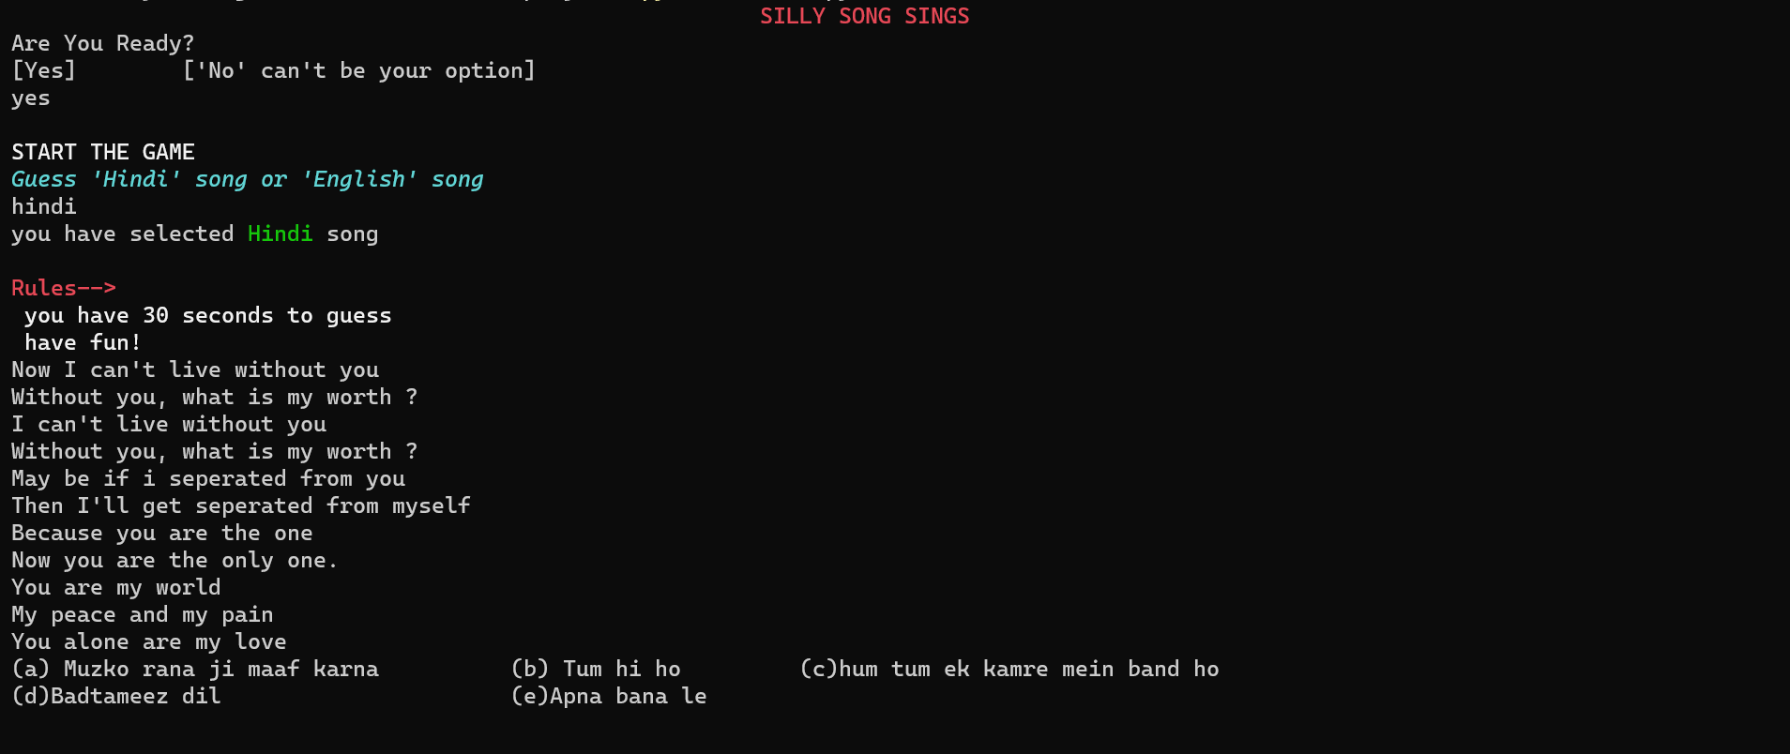
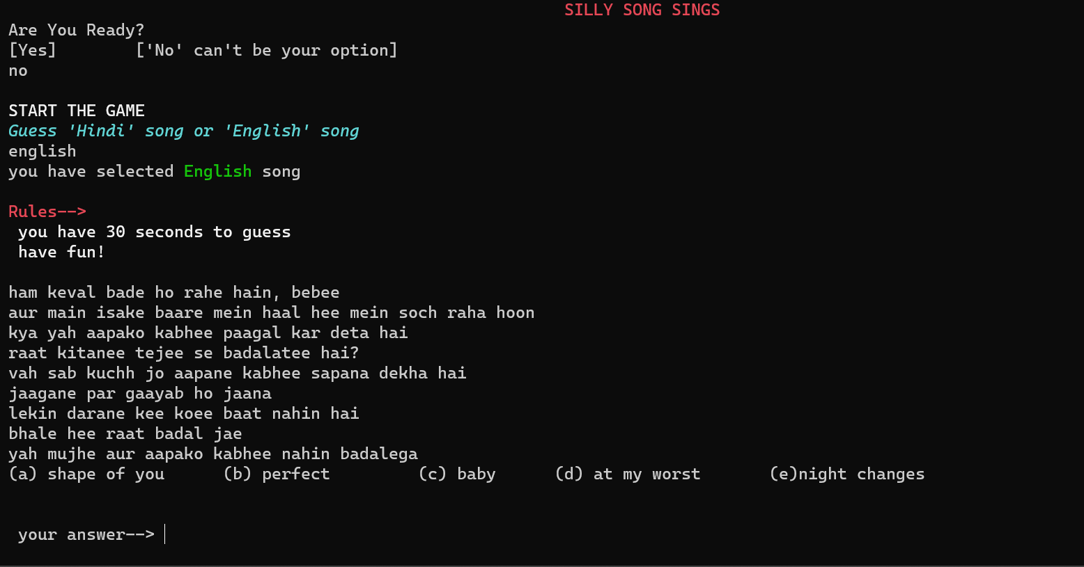
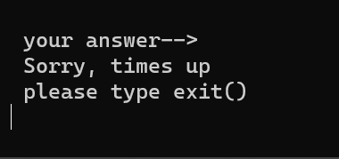
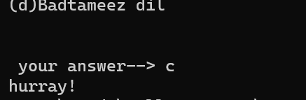
Results

